Slide 1
CORAL REEFS

Slide 2
Corals Overview
Coral reefs are underwater structures made from calcium carbonate secreted by coral polyps.
Although coral is often mistaken for a rock or a plant, it is actually composed of tiny, fragile animals called coral polyps. When people say coral, they are referring to these little animals and the skeletons they leave behind after they die.
Corals need sunlight, clear water, warm water temperature, clean water and salt water to survive.

Slide 3
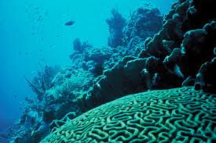
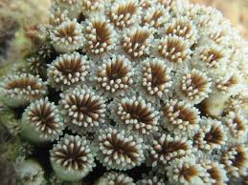
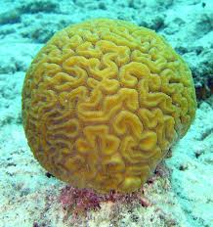
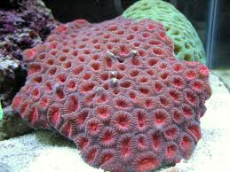

Slide 4
Types of Corals: Fringing Reefs
These grow near the coastline around islands and continents. They are separated from the shore by narrow, shallow lagoons. Fringing reefs are the most common type of coral reefs.

Slide 5
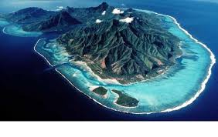

Slide 6
Types of Corals: Atoll
Atolls are rings of coral that create protected lagoons and are usually located in the middle of the sea.
Atolls usually form when islands surrounded by fringing reefs sink into the sea or the sea level rises around them (these islands are often the tops of underwater volcanoes).

Slide 7
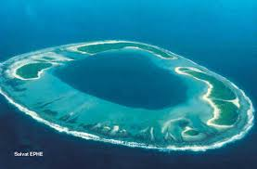

Slide 8
Types of Coral: Barrier Reef
Barrier reefs also parallel the coastline but are separated by deeper, wider lagoons. At their shallowest point they can reach the water's surface forming a "barrier" to navigation.
The Great Barrier Reef in Australia is the largest and most famous barrier reef in the world.
The Belize Barrier reef is the largest reef in the northern hemisphere.

Slide 9
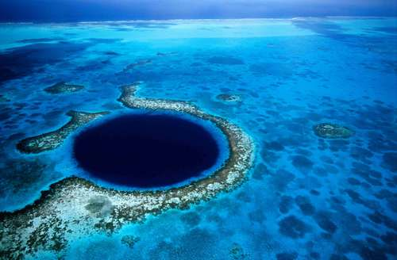
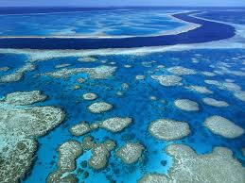

Slide 10
Threats to Corals
Coral bleaching as a result of climate change (global warming): Global warming is caused by the accumulation of carbon dioxide and other heat-trapping gasses in the atmosphere. These gases act as a blanket, preventing the heat of the sun to escape through our atmosphere. Coral reefs expels coral polyps from the corals when water temperature rises above 2⁰C so the corals appear bleached and the corals eventually die.

Slide 11
Rising sea levels: As a result of the excess heat due to climate change ice caps in polar regions melt causing sea levels to rise. This rise in sea level makes the coral reefs unable to photosynthesize as light cannot travel far in deep waters and they die. Also a rise in sea level may decrease the temperature of the water causing the coral polyps to die
Excess Carbon Dioxide: when excess Carbon dioxide enter the ocean two things can occur –
    Carbon dioxide will suffocate the coral polyps in the ocean
    Carbon dioxide will acidify the waters thereby inhibiting the ability of the coral polyps to secrete calcium carbonate to make up its skeleton

Slide 12
Water Pollution: oil, gas and pesticide contamination poisons coral and marine life. Reefs are harmed when human, animal waste and/or fertilizer is dumped into the ocean or when river systems carry these pollutants to reef waters. These pollutants increase the level of nitrogen around coral reefs, causing an overgrowth of algae, which smothers reefs by cutting off their sunlight. Plastic bags may also smother coral reefs.
Sedimentation: particles end up in the ocean and cover coral reefs. This 'smothers' coral and deprives it of the light it needs to survive

Slide 13
Destructive Fishing Practices: Overfishing is another leading cause for coral reef degradation. Often, too many fish are taken from one reef to sustain a population in that area. Poor fishing practices, such as banging on the reef with sticks, destroy coral formations that normally function as fish habitat. In some instances, people fish with explosives (blast fishing), which blast apart the surrounding coral.
Coral Mining: Sometimes coral pieces are removed for use as bricks or road-fill. Or, sand and limestone from coral reefs are made into cement for new buildings.

Slide 14
Careless Tourism: Tourist resorts that empty their sewage directly into the water surrounding coral reefs contribute to coral reef degradation. Wastes kept in poorly maintained septic tanks can also leak into surrounding ground water, eventually seeping out to the reefs. Careless boating, diving, snorkeling and fishing can also damage coral reefs. Whenever people grab, kick, walk on, or stir up sediment in the reefs, they contribute to coral reef destruction. Corals are also harmed or killed when people drop anchors on them or when people collect coral.

Slide 15
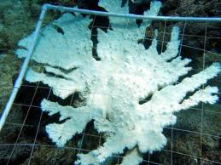
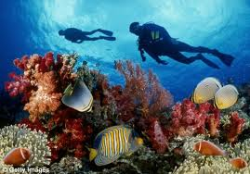
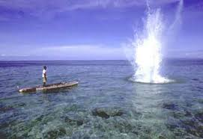
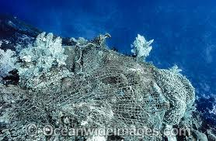

Slide 16
Importance of Corals
Adds to the aesthetic value of the sea. This gives foreign exchange in the tourism industry.
Provides a home for fishes and a safe ‘breeding’ ground for the fishes thereby aiding the fishing industry which generates Gross Domestic Product.
Protects the coast from erosion. Corals acts and wave breakers by decreasing the velocity and energy of the wave and thereby the level of erosion is decreased.

Slide 17
Coral reef sediments provides the material for white sandy beaches, spits (e.g. Palisadoes Spit) and bars. This occurs as breaking waves erode or breakup the coral reefs carrying sediments for the development of coastal features
Medicinal Purposes: Boulder corals are used as models for bone implants, several important drugs have already been developed from chemicals found in coral reefs. These drugs treat a range of different ailments e.g. cardiovascular diseases, ulcers, leukemia and skin cancers

Slide 18
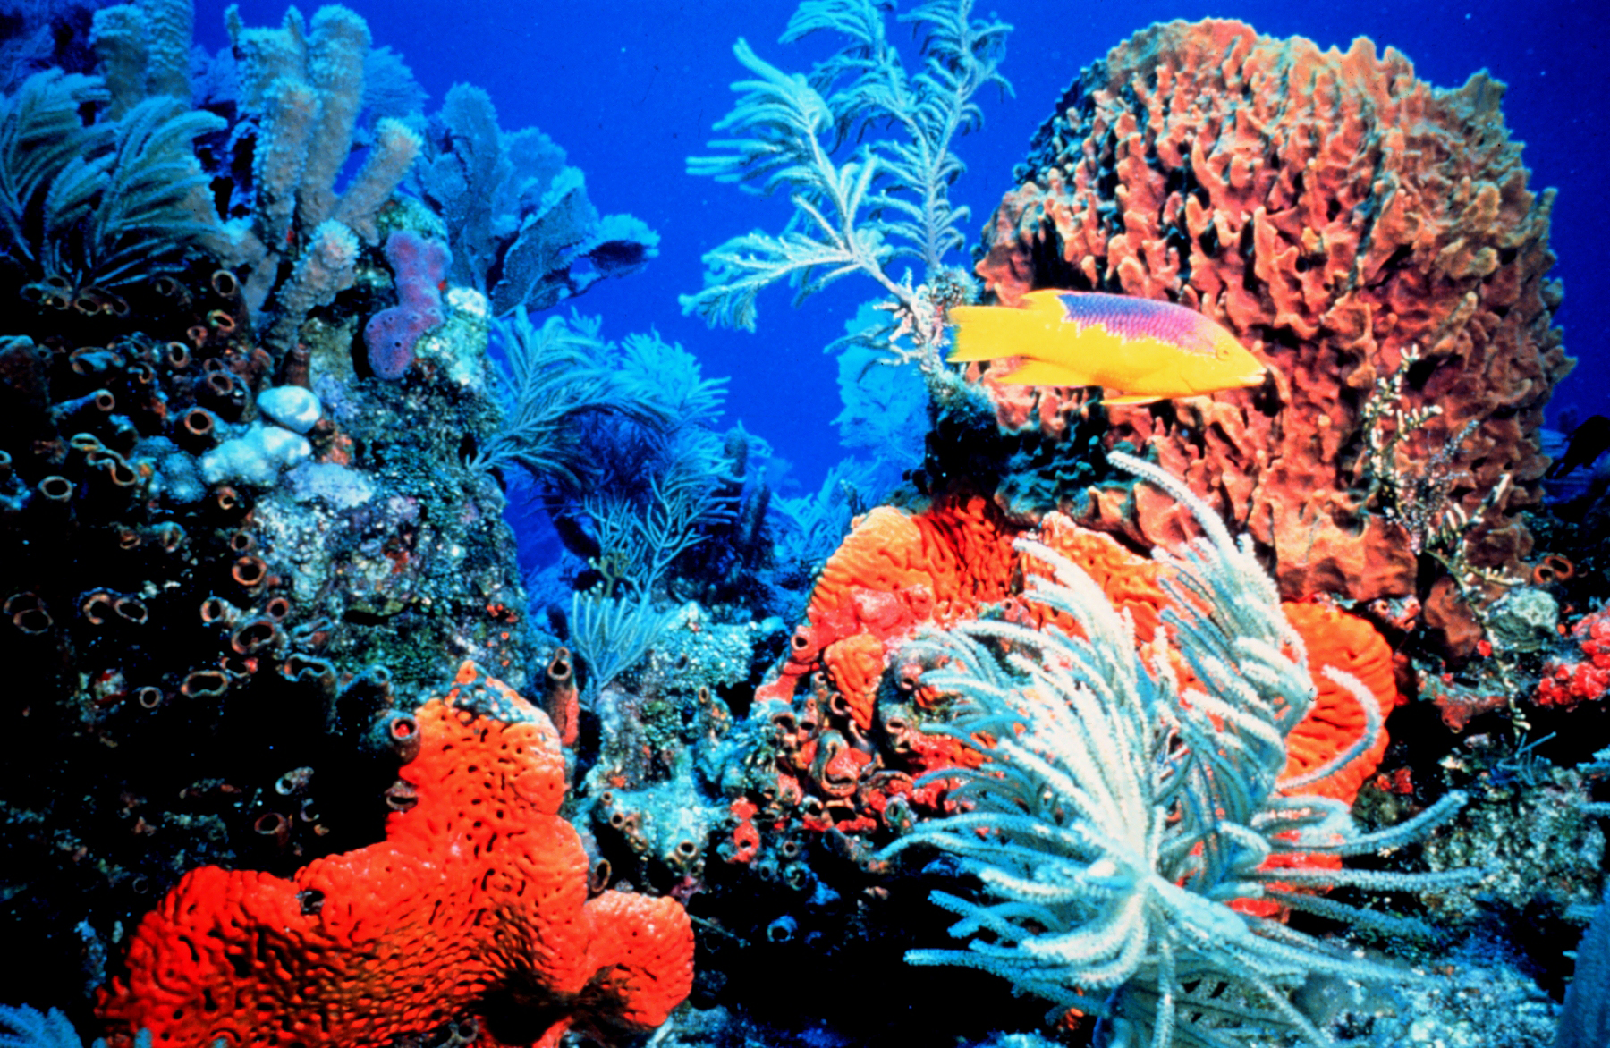
Coral reefs are a habitat for many marine organisms and also increases biodiversity. The variety of species living on coral reefs is greater than almost anywhere else in the world.

