Slide 1
Sociology and the Social Sciences
Sociologists:
  – Study the influence that society has on people’s attitudes and behavior
  – Seek to understand ways in which people interact and shape society

Slide 2
Sociology and Common Sense
Sociologists do not accept something as fact because “everyone knows it”
Findings are tested by researchers, analyzed in relation to other data, and evaluated with sociological theory

Slide 3
What Is
Sociological Theory?
Theory: set of statements that seeks to explain problems, actions, or behavior
  Effective theories have explanatory and predictive power
  Durkheim’s work on suicide provides a classic case of sociological theory at work

Slide 4
The scientific method includes selecting a researchable problem, reviewing the literature, formulating a hypothesis, creating an operational definition, choosing a research design, collecting the data, analyzing the data, and stating conclusions.
 It is important that sociologists observe the ethics of their discipline in carrying out research. They have an obligation to protect their research subjects from risk and harm and to protect these subjects’ rights and dignity.

Slide 5
Sociology and Science
1. Sociology is a type of science, a logical system that bases knowledge on direct, systematic observation.
  Scientific sociology is the study of society based on systematic observation of social behavior.
  Scientific knowledge is based on empirical evidence, information we can verify with our data, not common sense.
2. Scientific evidence sometimes contradicts common sense explanations of social behavior.
A. It is not what we do not know that get us into trouble, it is what we know that is not true.
3. Is there such a thing as objective reality??

Slide 6
Research, Values, and Biases
Sociologists strive for objectivity, a state of personal neutrality in conducting research, whenever possible following Max Weber’s model of value-free research.
  One way to limit distortion caused by personal values is through replication, repetition of research by others in order to assess its accuracy.
    More about this later.
Limitations of scientific sociology.
  Human behavior is too complex to allow sociologists to predict precisely any individual’s actions.
  Because humans respond to their surroundings, the mere presence of a researcher may affect the behavior being studied.
Social patterns change; what is true in one time or place may not hold true in another.

Slide 7
Because sociologists are part of the social world they study, being value-free when conducting social research is difficult.
  a. An alternative to Value Free is Interpretive sociology.
    Not biased, just the opposite
    Max Weber, argued that the focus of sociology is interpretation. Interpretive sociology is the study of society that focuses on the meanings people attach to their social world.
      The interpretive sociologist’s job is not just to observe what people do but to share in their world of meaning and come to appreciate why they act as they do.
  Another alternative is Critical sociology.
    Karl Marx, who founded critical sociology, rejected the idea that society exists as a “natural” system with a fixed order. Critical sociology is the study of society that focuses on the need for social change.
    The point is not merely to study the world as it is but to change it.

Slide 8
Research is affected by the characteristics of the researcher.
  We have to strive to overcome this.
  Research is affected by gender, the personal traits and social positions that members of a society attach to being female and male, in five ways:
    Androcentricity, or approaching an issue from the male perspective.
    Overgeneralizing, or using data drawn from studying only one sex to support conclusions about human behavior in general.
    Gender blindness, or not considering the variable of gender at all.
    Double standards.
    Interference because a subject reacts to the sex of the researcher
The American Sociological Association has established formal guidelines for conducting research. Most professional associations do the same thing.

Slide 9
Steps in the conduct of Scientific Sociological Research
  1. Select a topic guided by sociological perspective and curiosity.
    Frequently guided by the source of funding for the research.
  2. Define the problem in considerable detail, specifying exactly what you want to learn.
  3.. Review the literature to use what is already known about the topic. As a guide, and to generate ideas as to what questions to ask.
  4. Formulate your hypothesis, describing how you expect your variables to be related.
    Your variables need to be operationalized.
  5. Choose a research method, which we will discuss in a few minutes.
  6. Collect your data paying attention to the validity.
  7. Analyze your data.
  8. Disseminate by publishing or speaking at professional meetings, your findings.

Slide 10
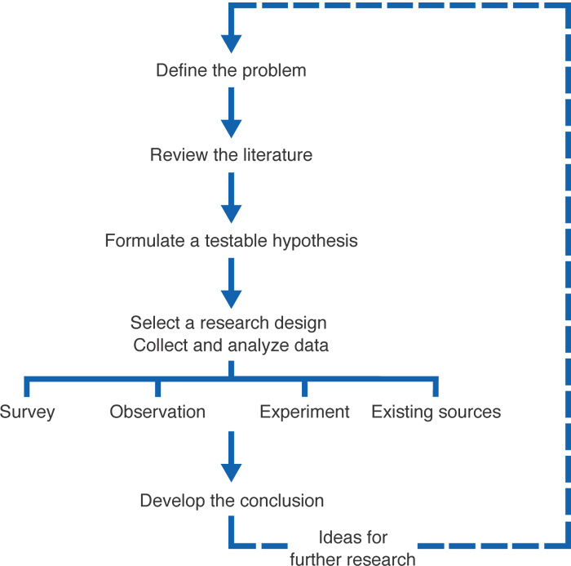
The Scientific Method

Slide 11
Steps in the Research
Process
Formulating the Hypothesis
  Hypothesis: testable statement about relationship between two or more variables
  Variable: measurable trait or characteristic subject to change under different conditions
    Independent variable: variable hypothesized to cause or influence another
    Dependent variable: variable subject to the influence of another variable

Slide 12
Steps in the Research
Process
Formulating the Hypothesis
  Causal logic: relationship between a condition or variable and a particular consequence, with one event leading to the other
  Correlation: exists when a change in one variable coincides with a change in another
Correlation does not necessarily indicate causation

Slide 13
The utility of Measurement
For a measurement to be useful, it must be reliable and valid.
  Reliability refers to consistency in measurement.
  Validity means precision in measuring exactly what one intends to measure.
There are two types of measurement
Nominal: expresses the essence of an idea in words
Operational: expresses the essence of an idea in terms that can be measured.

Slide 14
Collecting and Analyzing Data
Ensuring Validity and Reliability
  Validity: degree to which a measure or scale truly reflects the phenomenon under study
  Reliability: extent to which a measure produces consistent results

Slide 15
Collecting and Analyzing Data
Selecting the Sample
  Sample: selection from a larger population that is statistically representative of that population
  Random sample: when every member of an entire population has the same chance of being selected

Slide 16
The Basic Concepts of the Social Scientific Method
Concepts, variables, and measurement.
1. Concepts are mental constructs that represent some part of the world, inevitably in a simplified form.
2. Variables are concepts whose value changes from case to case, Constants do not change value.
3. Measurement is the process of determining the value of a variable in a specific case.
4. Statistical measures are frequently used to describe populations as a whole.
a) This requires that researchers operationalize variables, which mean specifying exactly what one is to measure in assigning a value to a variable

Slide 17
Three Useful (and Simple) Statistical Measures.
The mode is the value that occurs most often in a series of numbers.
The mean refers to the arithmetic average of a series of numbers.
The median is the value that occurs midway in a series of number arranged from lowest to highest.

Slide 18
Relationships among variables
Cause and effect is a relationship in which change in one variable causes change in another.
  The independent variable is the variable that causes the change.
  The dependent variable is the variable that changes.
  Cause-and-effect relationships allow us to predict how one pattern of behavior will produce another.
  Correlation exists when two (or more) variables change together.
  Spurious correlation means an apparent, although false, association between two (or more) variables caused by some other variable.
  Spurious correlations can be discovered through scientific control, the ability to neutralize the effect of one variable in order to assess relationships among other variables.

Slide 19
Developing the Conclusion
Supporting Hypotheses
  Sociological studies do not always generate data that support the original hypothesis
  Controlling for Other Factors
  • Control variable: factor that is held constant to test the relative impact of an independent variable

Slide 20
Survey Research
A survey is a research method in which subjects respond to a series of statements or questions in a questionnaire or an interview..
  Surveys are directed at populations, the people who are the focus of research.
  Usually we study a sample, a part of a population that represents the whole. Random sampling is commonly used to be sure that the sample is actually representative of the entire population.
  Surveys may involve questionnaires, a series of written questions a researcher presents to subjects.
  Questionnaires may be closed-ended or open-ended.
  Surveys may also take the form of interviews, a series of questions administered in person by a researcher to respondents.

Slide 21
Experiments
An experiment is a research method for investigating cause and effect under highly controlled conditions.
  Experimental research is explanatory, meaning that it asks not just what happens but why. Typically, researchers conduct experiments to test hypotheses, unverified statements of a relationship between variables. Most experiments are conducted in laboratories and employ experimental and control groups.
    The Hawthorne effect is a change in a subject’s behavior caused by the awareness of being studied.
The Stanford County Prison study was an experiment conducted by Philip Zimbardo that supported the notion that the character of prison itself, and not the personalities of prisoners and guards, causes prison violence.

Slide 22
  Questions: A Word or Two Makes All the Difference. How researchers word questions affects how the public responds.
  Lois Benjamin used interviews and snowball sampling to study one hundred elite African Americans. Benjamin concluded that, despite the improving social standing of African Americans, black people in the United States still experience racial hostility.
  Kinsey and his successors and the Mercury Magazine political predictions
Understanding Statistical data
Reading Tables: An Important Skill. A table provides a lot of information in a small amount of space, so learning to read tables can increase your reading efficiency

Slide 23
Participant Observation
Participant observation is a method by which researchers systematically observe people while joining in their routine activities. Participant observation research is descriptive and often exploratory. It is normally qualitative research, inquiry based on subjective impressions.
   William Whyte utilized this approach to study social life in a poor neighborhood in Boston. His research, published in the book Street Corner Society, illustrates the value of using a key informant in field research.
   Elliot Liebow studied unemployed Black men in Washington and published his results as Talley’s Corner

Slide 24
Secondary Analysis or Archival Research
A research method in which a researcher utilizes data collected by others.
E. Digby Baltzell’s Puritan Boston and Quaker Philadelphia explored reasons for the prominence of New Englanders in national life. This study exemplifies a researcher’s power to analyze the past using historical sources

Slide 25
Finally….
The interplay of theory and method.
  Inductive logical thought is reasoning that builds specific observations into general theory.
  Deductive logical thought is reasoning that transforms general ideas into specific hypotheses suitable for scientific testing.
  Most sociological research uses both types of logical thought.
People Lie with Statistics? The best way not to fall prey to statistical manipulation is to understand how people can mislead with statistics:
    People select their data.
    People interpret their data.
People use graphs to “spin” the truth
If you don’t understand this you WILL be fooled!

Slide 26
Steps in the Research
Process
Formulating the Hypothesis
  Hypothesis: testable statement about relationship between two or more variables
  Variable: measurable trait or characteristic subject to change under different conditions
    Independent variable: variable hypothesized to cause or influence another
    Dependent variable: variable subject to the influence of another variable

Slide 27
Steps in the Research
Process
Formulating the Hypothesis
  Causal logic: relationship between a condition or variable and a particular consequence, with one event leading to the other
  Correlation: exists when a change in one variable coincides with a change in another
Correlation does not necessarily indicate causation

Slide 28
Collecting and Analyzing Data
Selecting the Sample
  Sample: selection from a larger population that is statistically representative of that population
  Random sample: when every member of an entire population has the same chance of being selected

Slide 29
Collecting and Analyzing Data
Ensuring Validity and Reliability
  Validity: degree to which a measure or scale truly reflects the phenomenon under study
  Reliability: extent to which a measure produces consistent results

Slide 30
Developing the Conclusion
Supporting Hypotheses
  Sociological studies do not always generate data that support the original hypothesis
  Controlling for Other Factors
  • Control variable: factor that is held constant to test the relative impact of an independent variable

Slide 31
Research Ethics
Code of Ethics: first published by ASA in 1971
  Maintain objectivity and integrity in research
  Respect subject’s right to privacy and dignity
  Protect subjects from personal harm
  Preserve confidentiality
  Seek informed consent
  Acknowledge research collaboration and assistance
  Disclose all sources of financial support

Slide 32
Research Ethics
Confidentiality
  – Supreme Court has failed to clarify rights of scholars
Research Funding
  – Funding source should not taint objectivity of research
Value Neutrality
  Researchers should not allow personal feelings to influence interpretation of data

Slide 33
Feminist Methodology
Has had greatest influence on current generation of social researchers
Rejects notion of work and family as separate spheres
Has drawn attention to researchers’ tendency to overlook women in sociological studies

Slide 34
Government Involvement
Oversight by Institutional Review Boards !

